Slide 1



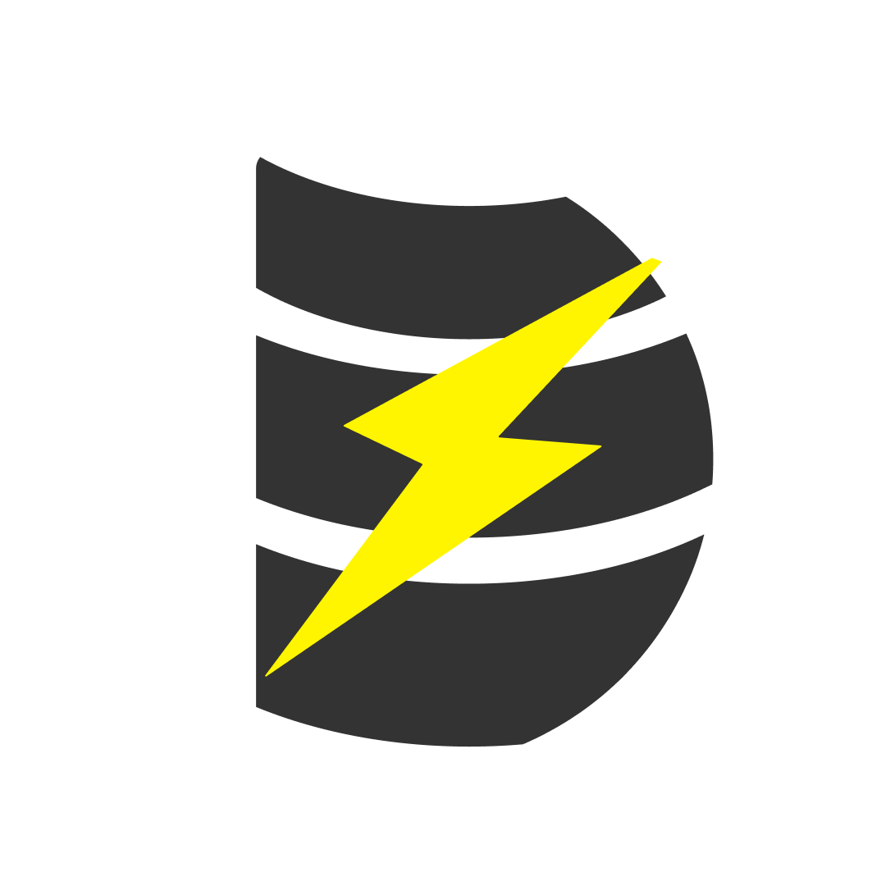

Snowflake & dbt Capabilities
Data availability to downstream systems when data is wiped out and reloaded by the CDC systems
PROBLEM STATEMENT
Source System
Attunity replicates the data from the Source system by looking at the Database transaction logs. The table in the source system is replicated into Snowflake by performing the "Apply Changes" option in Attunity.
Due to various reasons, when Attunity performs reload of the target table in Snowflake, the target table is first truncated and then the reload process starts. The reload could take few minutes to few hours to complete the reload, depending on the size of the table in the source system.
During this reload, any system(s) or users using these tables from Snowflake will have empty data until Attunity replication is complete

Slide 2
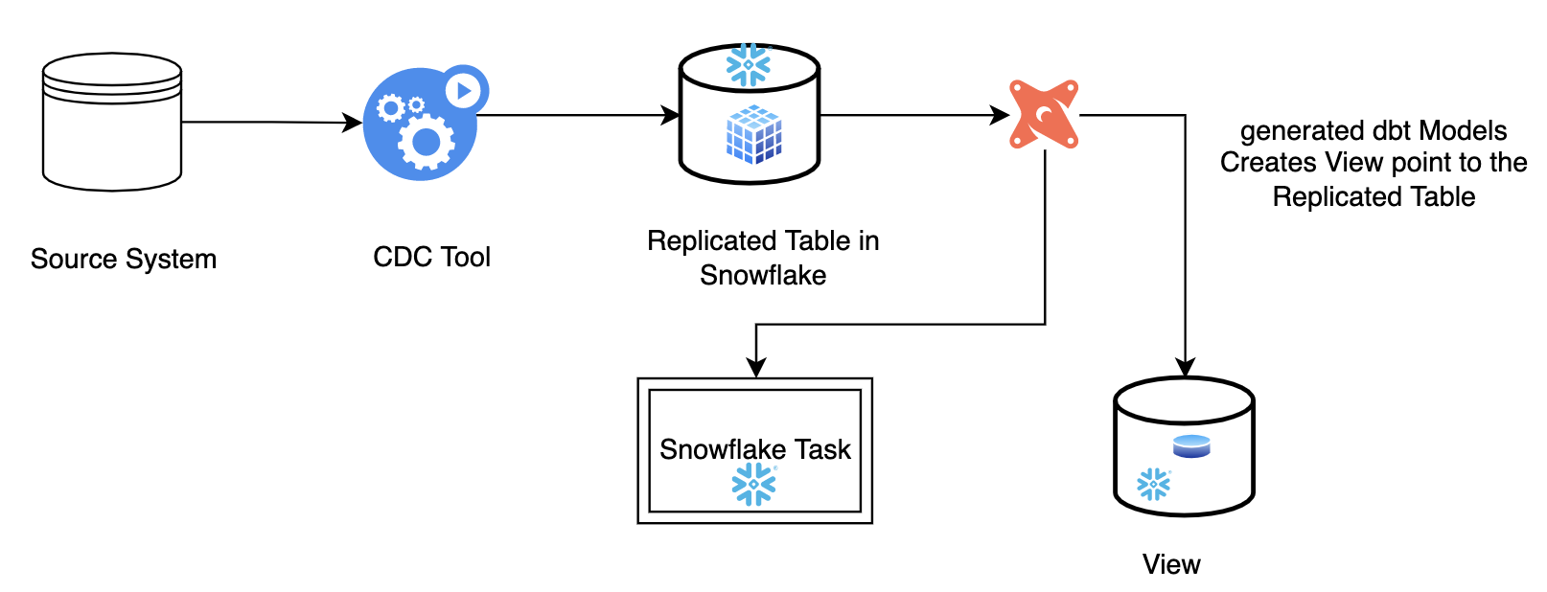
Snowflake & dbt Capabilities
Data availability to downstream systems when data is wiped out and reloaded by the CDC systems
SOLUTION
Part 1:
The auto generated dbt models will Create a View on top of the Table that is replicated by the CDC Tool
A Snowflake Task is also created within the same dbt Model (as Post Hook) To be executed every {{15}} Minutes to check for data consistency
The dbt models are executed only one time

Slide 3
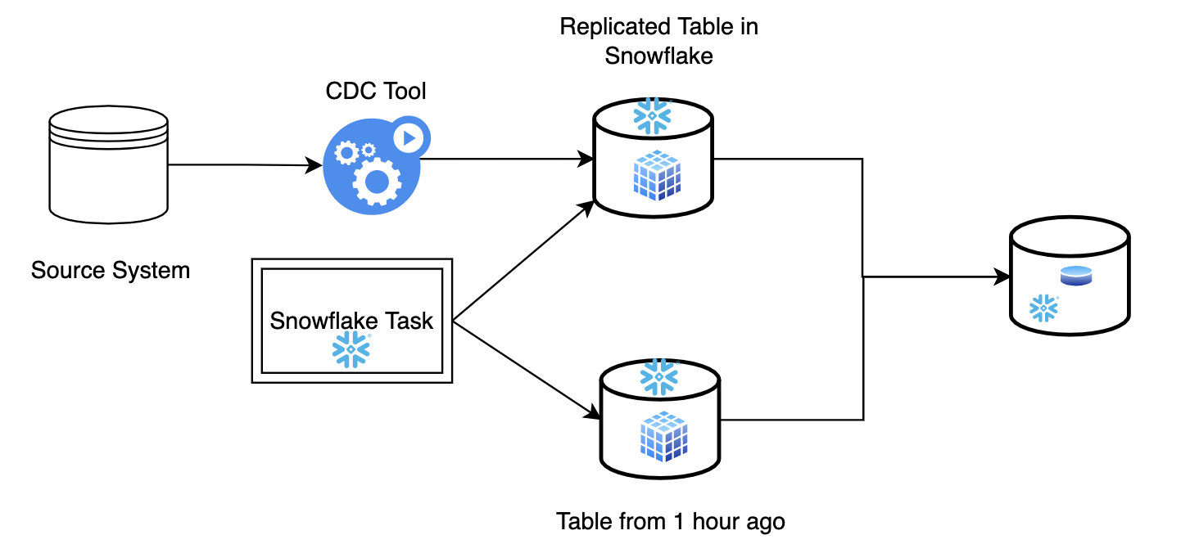
Snowflake & dbt Capabilities
Data availability to downstream systems when data is wiped out and reloaded by the CDC systems
Part 2:
The Snowflake Task runs every {{15}} minutes to check the current data size (row counts) of the table and compares against the data size {{an hour}} ago (using Snowflake Time-travel)
If the data size is {{75}}% lower than what it was {{1 hour}} ago, then create an _CLONE table with the data from {{1 hour}} ago using Snowflake Time-travel & Snowflake Zero-clone copy.
Modify the View to point to the Cloned table.
When the data in main table is back to required {{75%}} threshold, Repoint the View to the Main table as part of the Snowflake Task.
SOLUTION

